Slide 1

My Sport Nutrition Profile
Annie Varner
Adult Female, Age: 28
130 lbs 64 inches

Slide 2
BMI
BMI:
Wt (kg) =58.967 = 58.967 =
Ht (m²) 1.6256^2 2.6457536 22.3
BMI category: Healthy weight (18.5-24.9)
@190 lbs; BMI=32.5 (Obese); body fat %=36%
@130 lbs; BMI=22.5 (Healthy Weight); body fat %=21%

Slide 3

Estimating Daily Calorie Intake
Estimating calorie requirements (avg/day):
1) 10 calories/lb: 1300 calories
2) Harris-Benedict:
Female: RMR = 655.1 + (9.56 x kg) + (1.85 x cm) - (4.68 x age)
1300=655.1+(9.56x58,967)+(1.85x162.56)-(4.68x28)=1388.5
1300=655.1+563.72452+300.736-131.04=1388.5=RMR
Moderately Active (moderate exercise/sports 3-5 days/week) = RMR X 1.55
1388.5x1.55=2152
Total estimated energy needs (RMR x AF) =2152
3) Estimated Daily Energy (calorie) needs for training (Kundrat & Rockwell)
Activity Category : Moderate (1 – 1 ½ hr/day)
Calories/lb :19 – 21
Calculated calorie range/lb : 130 lbs x20=2600
4) Estimating Daily Energy Need for Male and Female Athletes (Dunford & Doyle)
Category-Moderate-intensity exercise
3-5 days/week or low-intensity and short-duration training daily
Energy expenditure for a female: 35
(35 kcal/58.967 kg/day)=2063.8

Slide 4
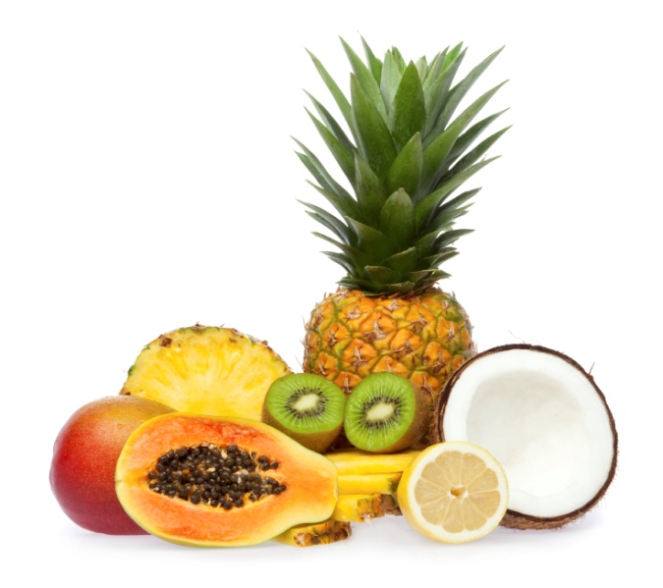
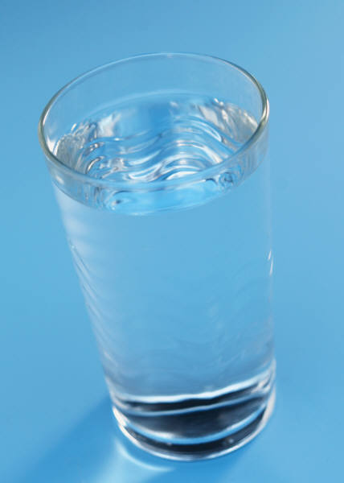
Recommended vs Needs
 | CHO range (g/kg) Recommended | CHO (g) needs* | PRO range (g/kg) Recommended | PRO (g) needs* | Fat range (%) Recommended | Fat (g) needs* | Fluid (ml) Recommended | Fluid (ml) needs*
Daily | 7 g/kg | 413 g | 1.0 g/kg | 59 g | 1.0 g/kg | 59 g | 637-1073 ml | 787 ml
Before: 3-5 hrs before Training/Competition | 3g/kg | 177 g | N/A | N/A | N/A | 10 g | 5-7 ml/kg | 295 ml
Before: 30-60 minutes before Training/Competition | 1g/kg | 59 g | N/A | N/A | N/A | N/A | 3-5 ml/kg | 177 ml
During | .5 g/kg | N/A | N/A | N/A | N/A | N/A | 150-350 ml | 300 ml
After/Recovery | 1.5g/kg | 86 g | 10-20 g | 10-15 g | N/A | N/A | 15 ml | 15 ml
CHO:
(59kg X7g/kg=413 g CHO;
=413gx4kcal/g=1652 kcal)
PRO:
(59kgx1g/kg=59 g PRO;
=59gx4kcal/g=236 kcal)
Fat:
59 kgx1g/kg=59 g fat;
=59gx9kcal/g=531 kcal)

Slide 5
My Personal
“Perfect Day”
Meal Plan
Monday, April 23, 2012
Breakfast
 | Calories | Fat | Carbohydrates | Protein
Milk, 1%, 1 cup | 110 | 2 | 12 | 8
Egg white, 1 serving | 17 | 0 | 0 | 5
Blueberries, fresh, 0.5 cup | 41 | 0 | 10 | 1
Raspberries, 0.5 cup | 30 | 0 | 7 | 1
Strawberries, fresh, 0.5 cup, halves | 23 | 0 | 5 | 0
Bread, whole wheat (including toast), 1 slice | 128 | 2 | 24 | 4
Blackberries, fresh, 0.5 cup | 37 | 0 | 9 | 1
Spinach, fresh, 0.5 cup | 3 | 0 | 1 | 0
*Flax Seed Meal (ground flax), 1 tbsp | 30 | 2 | 2 | 2
 | 420 | 8 | 71 | 21
Lunch
Romaine Lettuce (salad), 0.5 cup, shredded | 4 | 0 | 1 | 0
Spinach, fresh, 0.5 cup | 3 | 0 | 1 | 0
Italian Salad dressing, 2 tbsp | 137 | 14 | 3 | 0
Mangos, 1 cup, sliced | 107 | 0 | 28 | 1
Asparagus, fresh, 3 spear, small (5" long or less) | 8 | 0 | 2 | 1
Cabbage, red, fresh, 0.5 cup, chopped | 14 | 0 | 3 | 1
Cucumber (with peel), 0.5 cup slices | 7 | 0 | 1 | 0
Tomatoes, red, ripe, raw, year round average, 1 cup cherry tomatoes | 31 | 0 | 7 | 1
Applesauce, MUSSELMAN'S Lite, 1 serving | 50 | 0 | 12 | 0
 | 362 | 15 | 58 | 5
Dinner
Olive Oil, Extra Virgin, 1.5 tbs | 189 | 21 | 0 | 0
Veg: Yam, baked w/skin (1oz), 16 oz | 512 | 0 | 128 | 0
Cabbage, fresh, 0.5 cup, chopped | 11 | 0 | 2 | 1
Atlantic Salmon (fish), 3 oz | 155 | 7 | 0 | 22
Apple juice, unsweetened, 1 cup | 117 | 0 | 29 | 0
 | 983 | 28 | 159 | 22
Snack
Oranges, 1 large (3-1/16" dia) | 86 | 0 | 22 | 2
Almond Milk w/ Calcium, 1 cup | 80 | 3 | 11 | 2
Carrots, raw, 1 cup, chopped | 52 | 0 | 12 | 1
Whole Wheat Hard Pretzels, 3 oz | 308 | 2 | 69 | 9
 | 527 | 5 | 114 | 14
 | 2,292 | 57 | 401 | 63
 | 1490 - 1840 | 33 - 72 | 168 - 299 | 60 - 161
Challenging to reach carbohydrate, protein, and fat recommendations; without falling short on micronutrient recommendations.
Taking a Multivitamin.
Eating a 16 ounce Yam to meet Carbohydrate recommendations!
Consuming a 3 ounce filet of Salmon for dinner to not go over protein recommendations.
Portion is IMPORTANT.

Slide 6
Where my calories are coming from:
10.6% Proteins 67.7% Carbohydrates 21.7% Fats

Slide 7
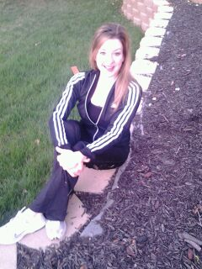
Regular Exercise
Minutes/day | Monday | Tuesday | Wednesday | Thursday | Friday | Saturday | Sunday
Cardio (low intensity)
Cardio (low-moderate intensity) | 30 |  | 30 | 30 | 30 |  | 30
Cardio (moderate-high intensity)
Strength (low-moderate intensity)
Strength (moderate-high intensity) |  | 30 |  | 30 |  | 30
Flexibility | 30 |  | 30 |  | 30 |  | 30
Total: 6 Hours of Planned Exercise per Week
Cardio Aerobic workout
Yoga and Pilates for Flexibility
Weight training/less weight more reps

Slide 8
Water Consumption and Electrolytes
Electrolytes: Sodium & Potassium
Electrolyte loss is related to muscle cramping during and following exercise.
Replenish with 3 oz sea salted whole wheat pretzels after exercise.
WATER CONSUMPTION:
Daily
Before: 3-5 hrs before Training/Competition
Before: 30-60 minutes before Training/Competition
During
After/Recovery
Fluid (ml) Recommended | Fluid (ml) needs*
637-1073 ml | 787 ml
5-7 ml/kg | 295 ml
3-5 ml/kg | 177 ml
150-350 ml | 300 ml
15 ml | 15 ml

Slide 9
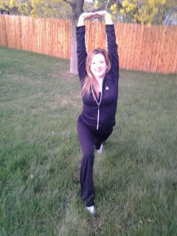
Vitamins and Minerals
Increased need for………..
Vitamin D-Regulates cardiac and skeletal muscle.
Calcium-Muscle Contraction, nerve conduction, secretion of hormones and enzymes.
Iron-Component of hemoglobin, necessary for oxygen and carbon dioxide transport; component of enzymes necessary for cellular use of oxygen, immune system function.
*Talking a multivitamin that includes all 3 of these nutrients.

Slide 10
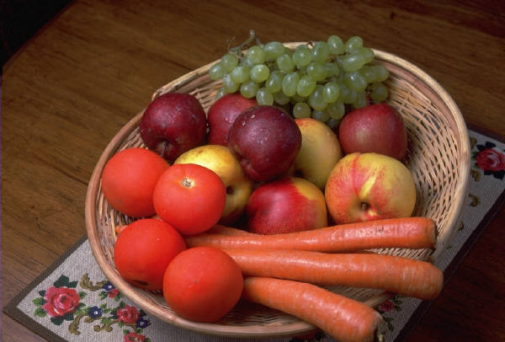
Questions?

